Slide 1
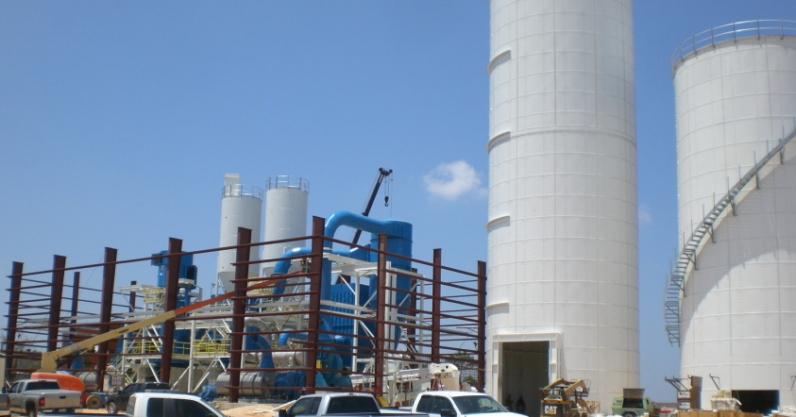
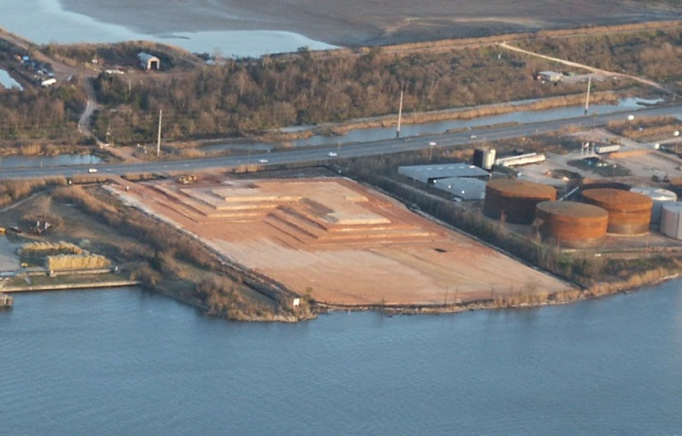
LIMESTONE GRINDING - RTS
Project: RTS (Mississippi Lime), Mobile, AL
New Lime Grinding Facility
Scope: Detail discipline engineering
Foundations and buildings
Mechanical and piping
Electrical
Equipment installation
Start-up
Project Equipment:
Conveyors & material handling
Grinding mills
Product storage
Load out

Slide 2
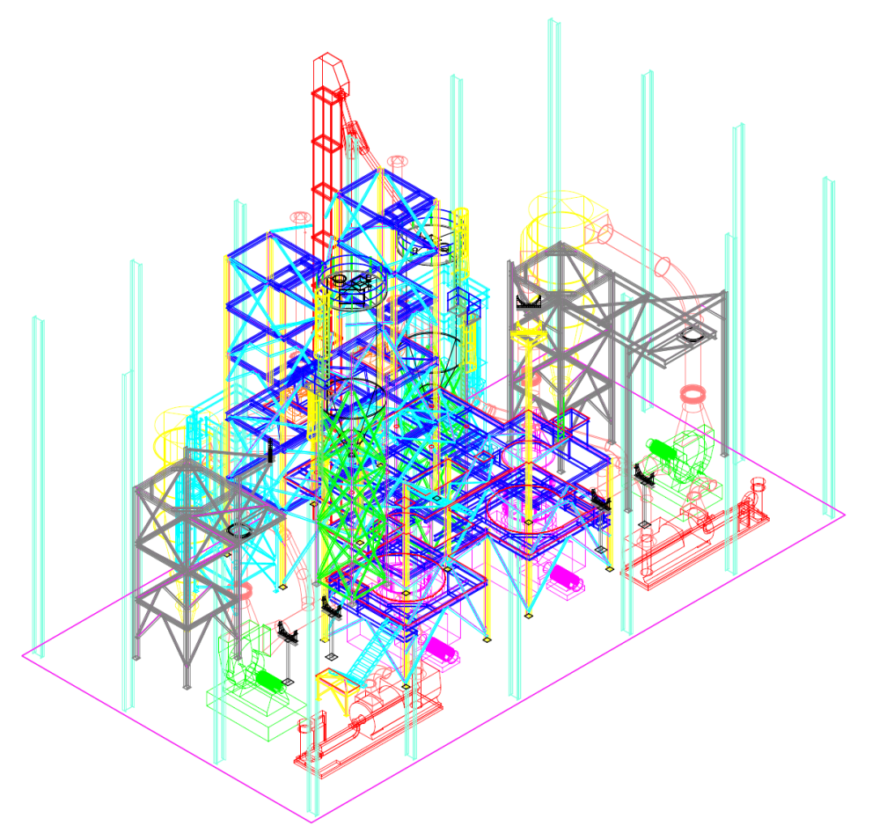
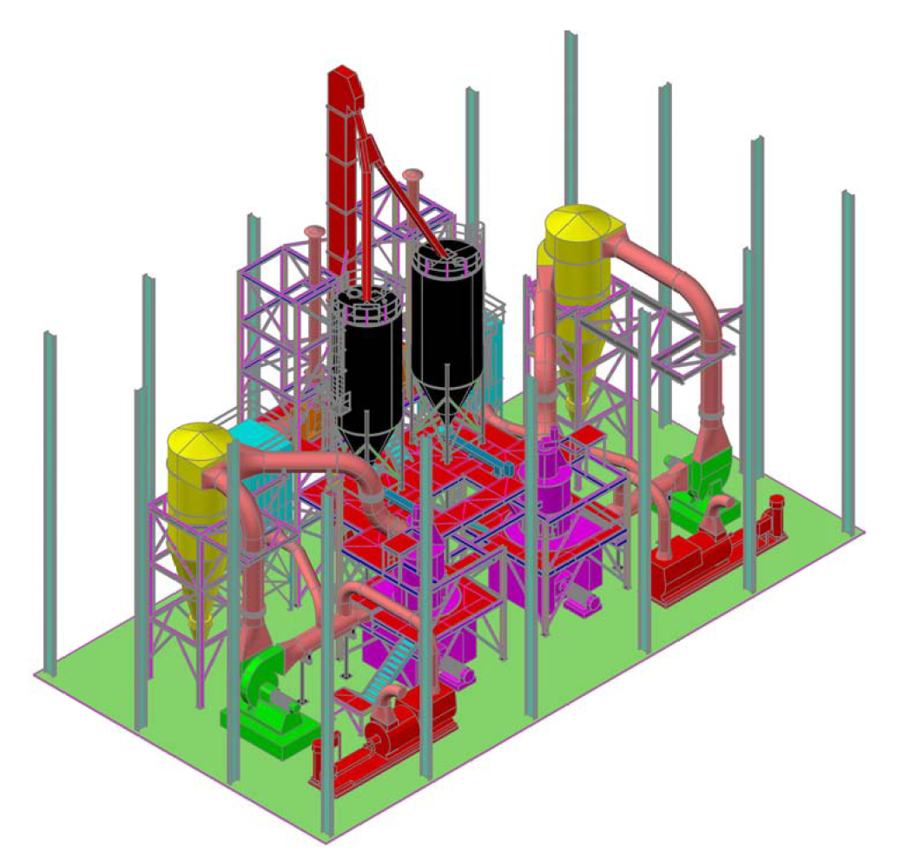
LIMESTONE GRINDING - RTS
3D Engineering model for design and interference detection
Intelligent 3D Model
Shaded 3D Model for walkthrough and constructability

